Slide 1

COMPOSITE MATERIALS
In AIRCRAFT
Ann Ivanova,
Irina Keltsieva,
MT8-62

Slide 2
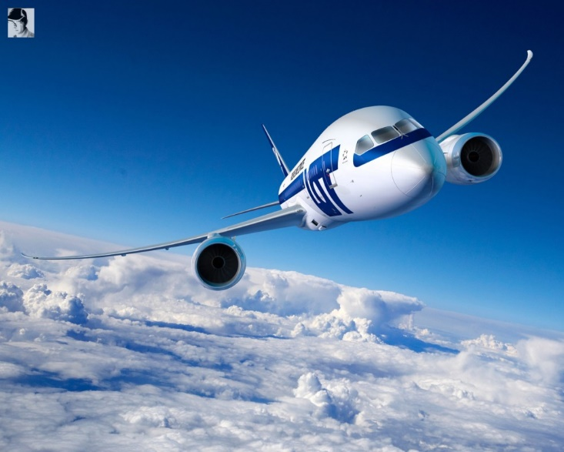
Content:
1. History of composites in aircraft
2. Common composite materials used in aviation
3. Advantages of the composite materials
4. The future of composite materials

Slide 3
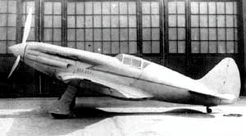
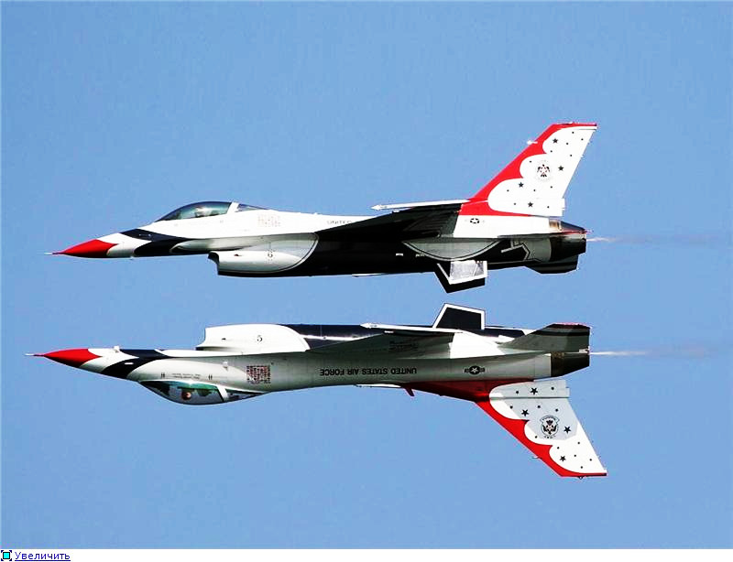
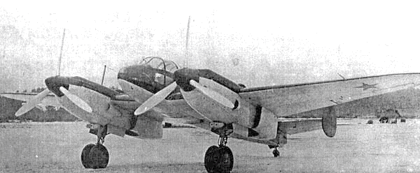
History of composites in aircraft
I-200/MiG-3
Yak-4

Slide 4
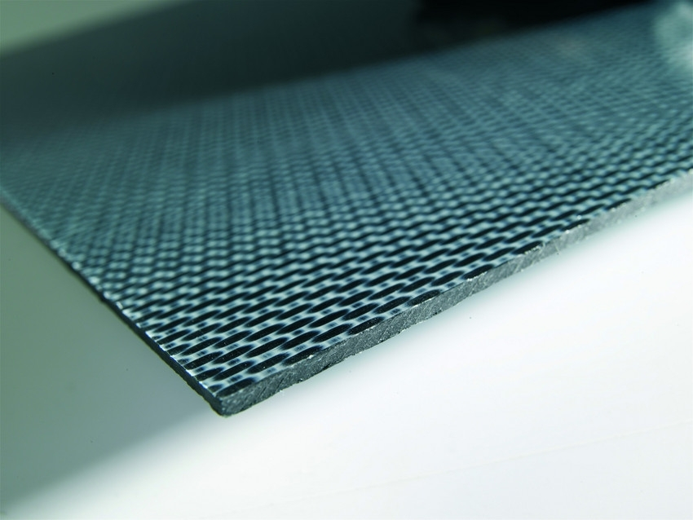
Common composite materials
used in aviation are
carbon fiber
glass- reinforced epoxy
aramid- reinforced epoxy

Slide 5
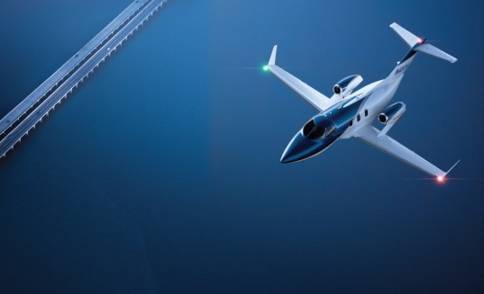
Advantages:
reduced weight
strong fiber-reinforced system
a smooth surface
increase fuel efficiency.

Slide 6
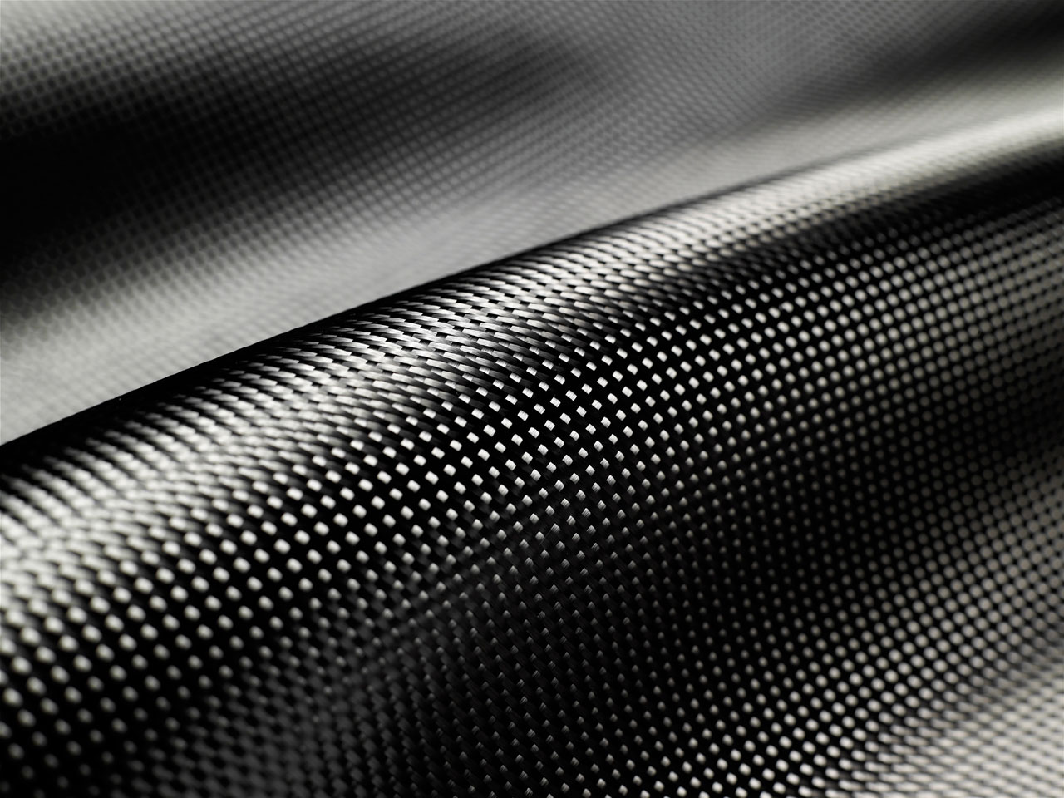
Carbon fiber

Slide 7
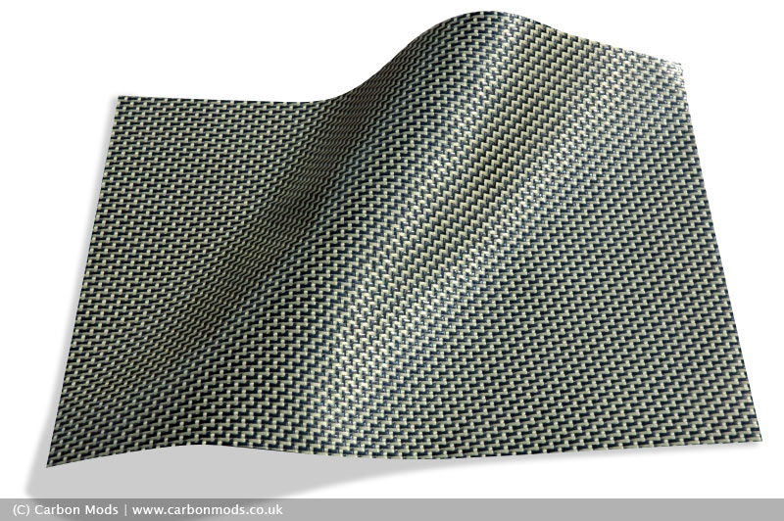
Aramid fibers ('Kevlar')

Slide 8
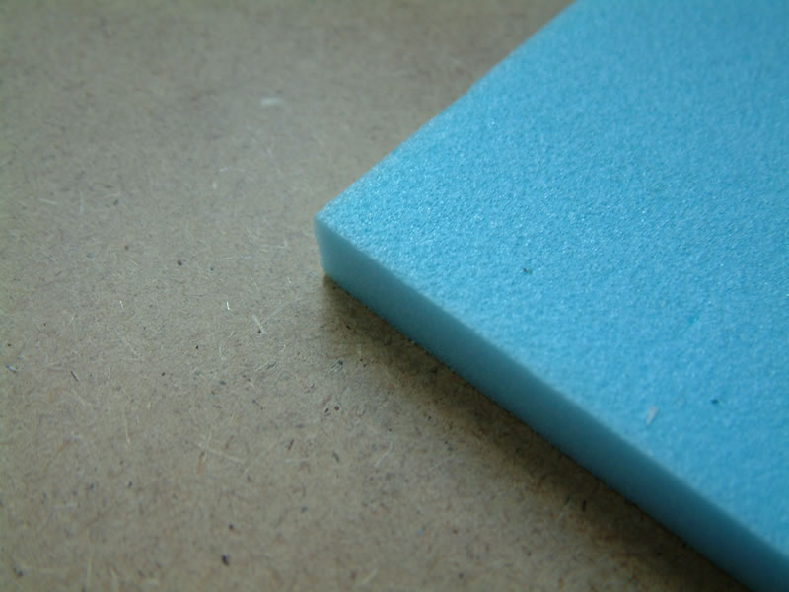
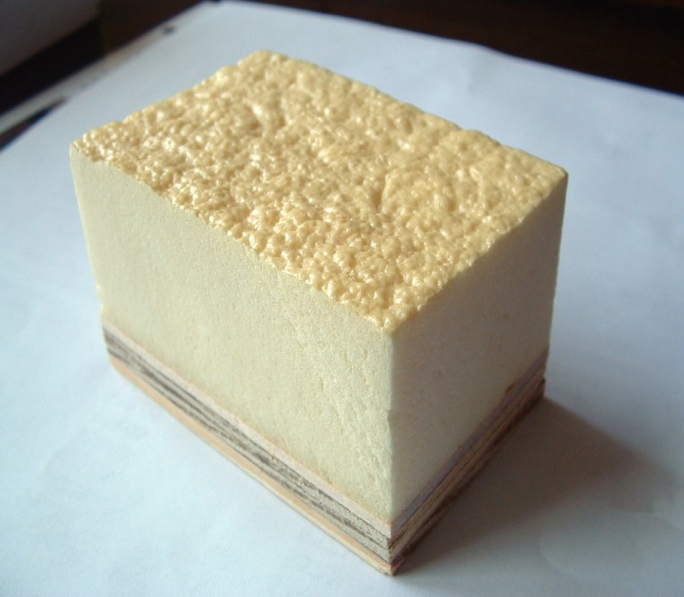
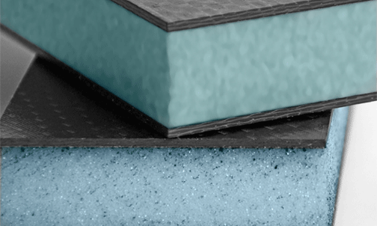
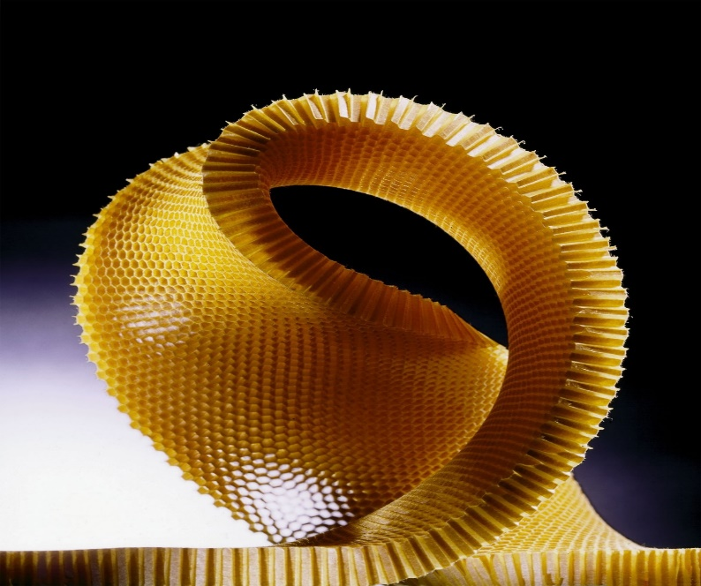
Core Materials
Foams:
Polystyrene
Polyurethane
Polyvinyl chloride
Honeycomb:

Slide 9
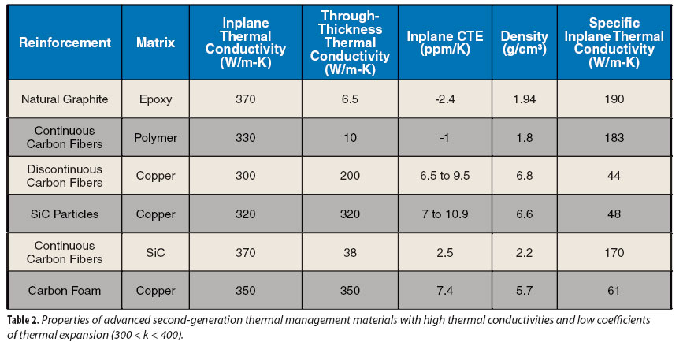
Main properties of some composites:

Slide 10
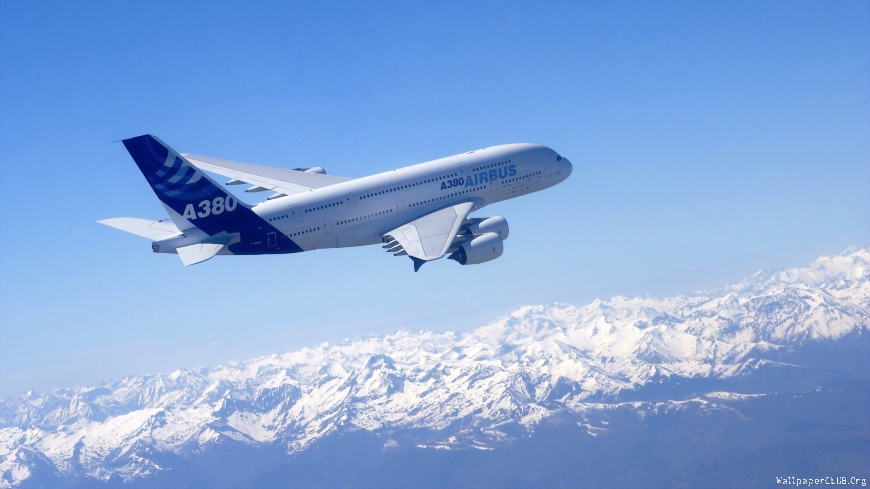
Thank you!

